Slide 1
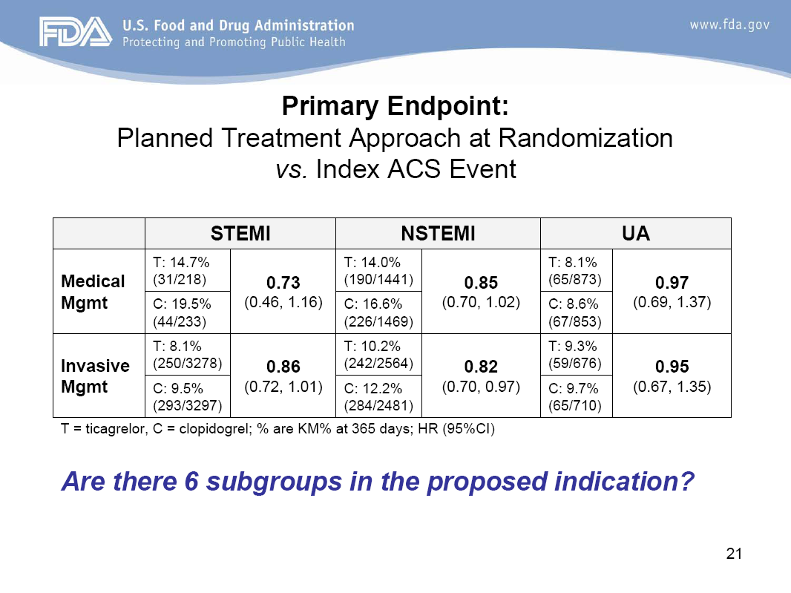
Ticagrelor DOES NOT provide superior benefit for UA patients
Primary endpoint:
Planned treatment approach at randomisation vs index ACS event
 | STEMI |  | NSTEMI |  | UA
Medical Mgmt | T: 14.7% (31/218) | 0.73 (0.46, 1.16) | T: 14.0% (190/1441) | 0.85 (0.70, 1.02) | T: 8.1% (65/873) | 0.97 (0.69, 1.37)
 | C: 19.5% (44/233) |  | C: 16.6% (226/1469) |  | C: 8.6% (67/853)
Invasive Mgmt | T: 8.1% (250/3278) | 0.86 (0.72, 1.01) | T: 10.2% (242/2564) | 0.82 (0.70, 0.97) | T: 9.3% (59/676) | 0.95 (0.67, 1.35)
 | C: 9.5% (293/3297) |  | C: 12.2% (284/2481) |  | C: 9.7% (65/710)
T = ticagrelor, C = clopidogrel, % are KM% at 365 days; HR (95% CI)
p=NS

